Slide 1


Faculty of Computing and Informatics
Week 10
Relational Algebra and JOINS
Database Implementation

Slide 2
Recap
In the previous lesson, we discussed
the SELECT command
Use various clauses with SELECT

Slide 3
Objectives
By the end of this lesson, students should be able to :
Extract data from various relations, joins
Describe and use basic operators
Identify syntax for various operations
Translate relational algebra expressions to SQL statements (vice versa)

Slide 4
Joins
This is used to combine data from two different relations(tables) into one and fetch data from the combined relation
Theta join or inner join
    R ⋈<join condition>^{S}
    Combines rows from two tables into a single record for records meeting the join condition

Slide 5

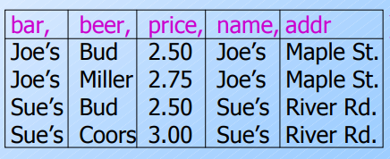
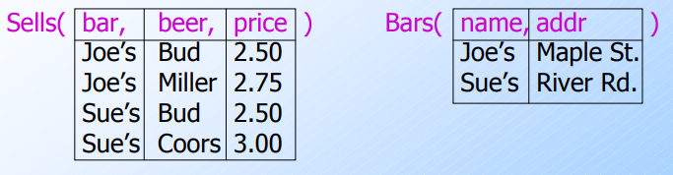
Theta Join
Consider these two relations

Slide 6
JOINS
  Joins clause is used to combine records from two or more tables in a database. A JOIN is a means for combining fields from two tables by using values common to each.
  INNER JOIN is used to select data that have matching records in both tables
  SELECT column_name(s)
  FROM table1
  INNER JOIN table2
  ON table1.column_name = table2.column_name;
  LEFT JOIN selects data from the left table that have been matched to the right table
  SELECT column_name(s)
  FROM table1
  LEFT OUTER JOIN table2
  ON table1.column_name = table2.column_name;

Slide 7
Natural Join Operator
Also known as a binary operator
R ⋈ S
Enforces equality on the attributes that have the same name
  If we have two tables A and B. Student id in table A is identical to student id in table B, then it retrieves details for both records.
Removes one copy of duplicate attributes
  Since we are selecting the same information from table A and table B, natural join just displays one information.

Slide 8

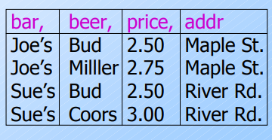
Natural Joins

Slide 9
Natural Join
Consider these two relations

Slide 10
JOINS
RIGHT JOIN selects data from the right table that have been matched to the left table
SELECT column_name(s)
FROM table1
RIGHT OUTER JOIN table2
ON table1.column_name = table2.column_name;
FULL OUTER JOIN selects data when there is a match in the left or right table.
SELECT column_name(s)
FROM table1
FULL OUTER JOIN table2
ON table1.column_name = table2.column_name
WHERE condition;

Slide 11

JOINS
SELF JOIN is used when you want to join a table to itself
SELECT column_name(s)
FROM table1 T1 JOIN table1 T2
WHERE condition;

Slide 12
Union
The operation take two input relations, which must be union-compatible:
  Same number of fields.
  `Corresponding’ fields have the same type.
  Duplicate tuples are automatically eliminated.
r U s
Where r and s are either database relations or relation result set (temporary relation).

Slide 13
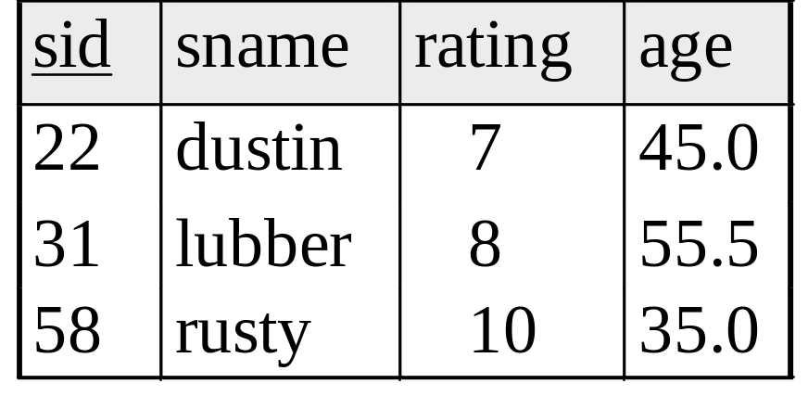
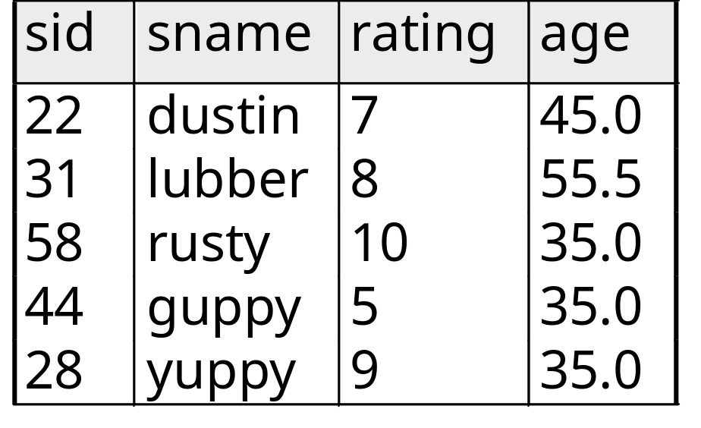
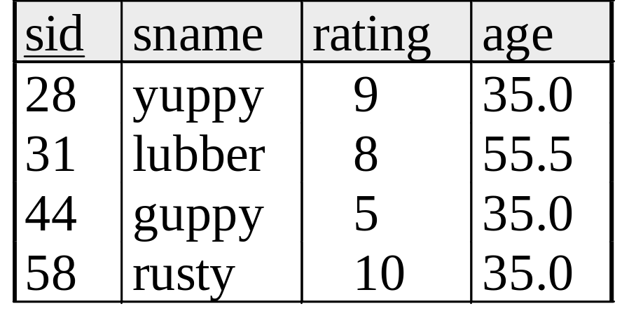

Union U
S1
S2

Slide 14
Set Difference -
The result of set difference operation is tuples, which are present in one relation but are not in the second relation.
r − s

Slide 15
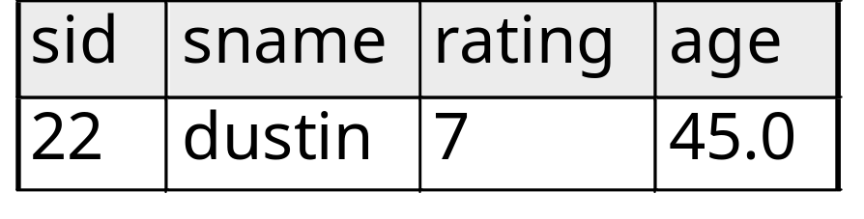

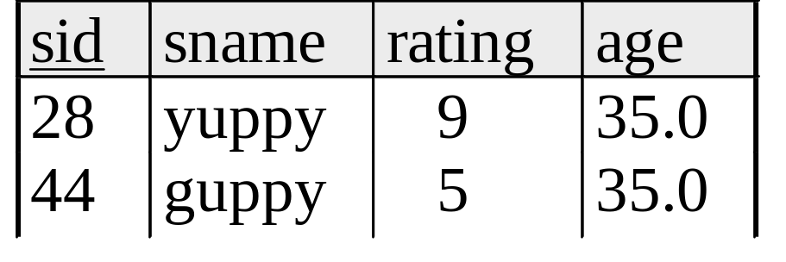
Set Difference -
S1
S2 – S1
S2

Slide 16
Cartesian-Product X
S1 × R1: Each row of S1 paired with each row of R1.
Result schema has one field per field of S1 and R1, with field names `inherited’ if possible.
  May have a naming conflict: Both S1 and R1 have a field with the same name.
  In this case, can use the renaming operator:

Slide 17
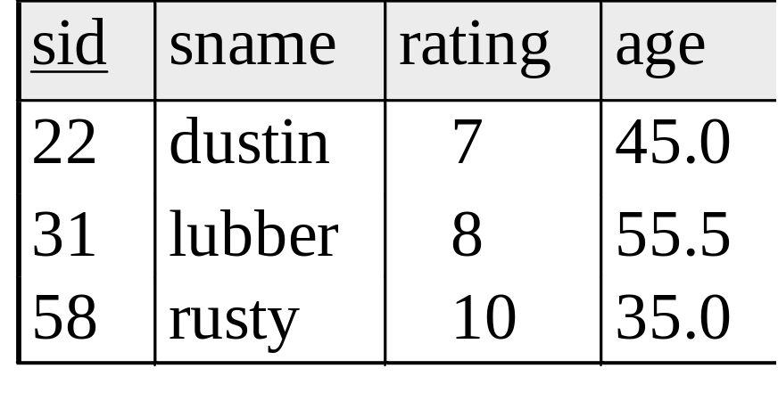
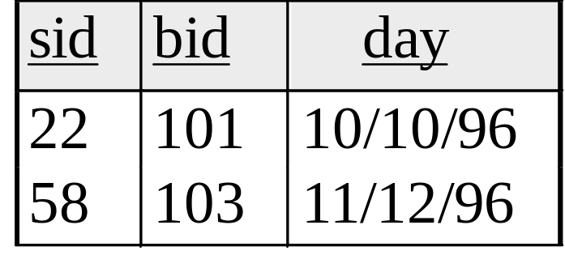
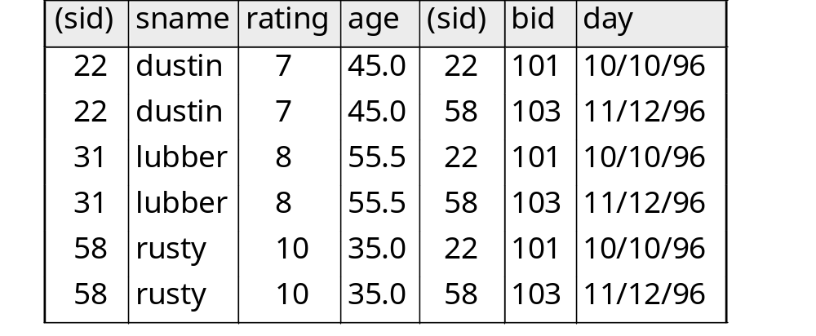
Cartesian Product Example
R1
S1
S1 x R1 =

Slide 18
Intersection
Intersection takes two input relations, which must be union-compatible.

Slide 19
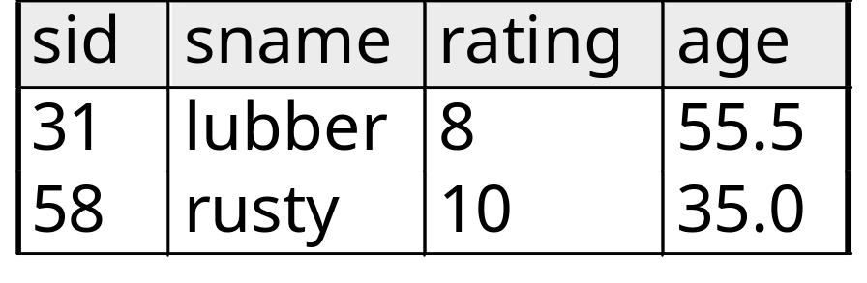

Intersection
S1
S2

Slide 20
Relational Algebra
is a procedural query language used to query the database tables to access data in different ways.
provides sets of operators to perform queries.​
input is a relation and output is also a temporary relation also know as a result set.
Notes:
input is a relation(table from which data has to be accessed) and output is also a relation(a temporary table holding the data asked for by the user).

Slide 21
Relational Algebra
5 Basic Operations
1. Selection ( σ ) Selects a subset of rows from relation (horizontal).
2. Projection ( π ) Retains only wanted columns from relation (vertical).
3. Cross-product ( × ) Allows us to combine two relations.
4. Set-difference ( — ) Tuples in r1, but not in r2.
5. Union ( ∪ ) Tuples in r1 or in r2.

Slide 22
Selection σ
The select operator returns results that meets a condition.
Result is a relation.
^{σ}<select condition> ^{(R)}
Where
σ is the selection operator
<select condition> - the specific condition
(R) is the name of the relation
The condition is built using operators like =, >, < , AND,OR

Slide 23
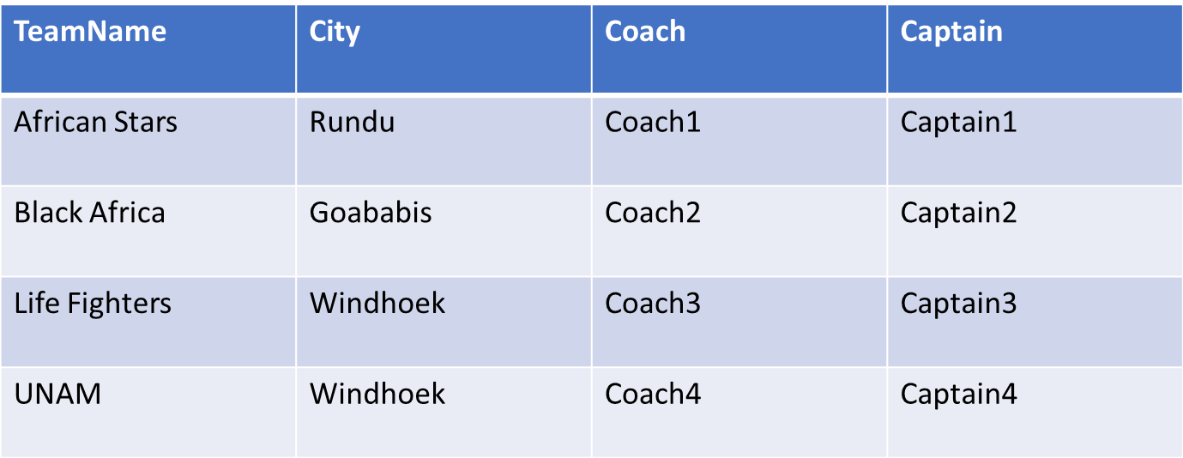
Select Operation
σ_{age > 17} (Student)
σ_{age > 17} (Student)
σ_{City =“Rundu”} (Team) will be
Select * from Team where City = ‘Rundu’;
Notes:
σ_{City =‘Rundu’} (Team)
Select * from Team where City = ‘Rundu’;

Slide 24

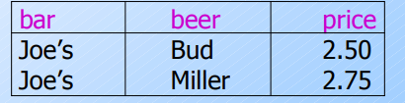
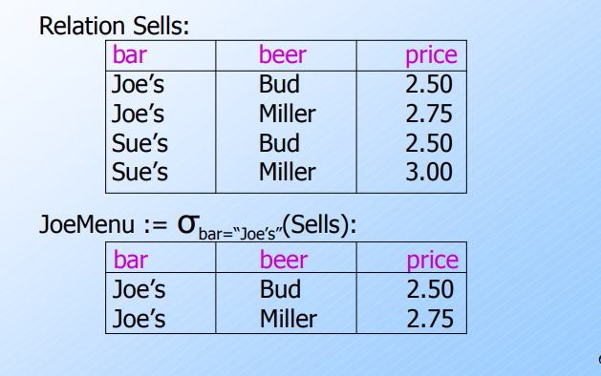
Selection
Result set

Slide 25
Select Operator
Example
    ^{σ}Minister_Id IN (100, 200, 300) AND salary >= 100^{(Minister)}
This operation presented would read as
  σ – select
  <select condition> - select query which meets the two conditions i.e Minister_Id as in the list with a salary greater or equal to 100.
  (R) – in this case is Minister thus the query will be retrieved from the Minister table

Slide 26
Select Operator
Exercises
What do the following Relational Algebra expressions mean?
^{σ}Minister_marital_status = ‘M’ OR salary > 5000^{(Minister)}
^{σ}employee_dob > ’01-MARCH-1999’^{(Employee)}
Translate the following select statement to relational algebra expressions
      SELECT first_name, last_name, date_of_birth, sex
      FROM EMPLOYEE
      WHERE graduation_school = ‘Harvard’ AND Qualification = ‘MSc’ AND graduation_year = ‘2007’

Slide 27
Project Operation π
used to project only a certain set of attributes of a relation, removing duplicate data
Retains only attributes that are in the “projection list”.
Schema of result: exactly the fields in the projection list, with the same names that they had in the input relation.
    ^{π}<attribute list> ^{(R)}
Notes:
∏_{Name, Age}(Student)

Slide 28
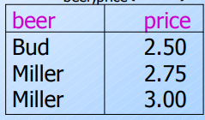
Projection π
Result set

Slide 29
Project Operator
Example
    ^{π} first_name, last_name, date_of_birth, salary^{(Employee)}
This operation presented would read as
  ^{π} – select a distinct result
  <attribute list> - the list of columns to be retrieved
  (R) – in this case, is Employee
    The query will be retrieved from the Employee table

Slide 30
Activity-Projection
What will be the result set given ?
∏_{TeamName, City}(Team)

Slide 31
Activity Projection -Answer

Slide 32
Project Operator
Exercise
    ^{π} first_name, last_name, date_of_birth, salary^{(Employee)}
Translate the following relational algebra expression to SQL query
    ^{π} Lecturer_surname, Lecturer_date_of_birth^{(Lecturer)}
    ^{π} Student_id, Student_course, student_admission_year^{(Student)}
    ^{π} Staff_name, Staff_id, staff_date_of_birth^{(Staff)}

Slide 33
Rename Operation ρ
This operation is used to rename the output relation for any query operation which returns result like Select, Project
    ρ _{S}^{(R)}
  ρ – a rename operator
  S- the new name of the relation
  (R) – the name of the relation to be changed

Slide 34
Rename Operation
  Renaming attribute
    ρ _{(Attr1…Attrn)}^{(R)}
  Renaming relation and its attribute
    Ρ_{S(Attr1…Attrn)}^{(R)}
  ρ _{Minister_Accommodation}^{(Accommodation)}
    Renames the Accomdation table to Minister_Accommodation

Slide 35
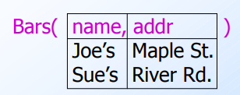
Rename
Consider this relation
1. rename the attribute name to bar

Slide 36

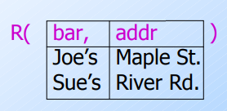
Rename

Slide 37
Activity
Write the relational Algebraic statement to:
Rename the following attribute Coach and Captain to TeamCoach and TeamCap respectively
Rename the Team relation to PlayerDetails

Slide 38
Summary
In this lesson we discussed
Joins
Relational Algebra
Syntax of basic operators

Slide 39
Announcements
Lab Marks (follow up with practical lecturers)
Attend practical classes

